Slide 1
Network Operating System

Slide 2
PC Operating Systems
Microsoft Windows is the most popular
Installed more than other OS combined
Installed on about 95% of computers
Apple and Linux represent the other 5%
Notes:
Teaching tip
Www.w3schools.com/browsers/browsers_stats.asp provides a neutral look at OS statistics. Refer to this page as you lecture. Visit www.wordiq.com/definition/Microsoft_Windows for an excellent timeline and description of Windows operating systems.

Slide 3
PC Operating Systems
DOS
Disk Operating System
Single user single-tasking OS
Command line interface
16-bit OS
Powerful
Fast
Supports legacy applications
Notes:
Teaching tip
Students often fail to see the value in older OS or applications. As an example, a metal fabrication plant in Pittsburgh PA is still using a program written in the early 70’s that calculates metal temperatures.

Slide 4
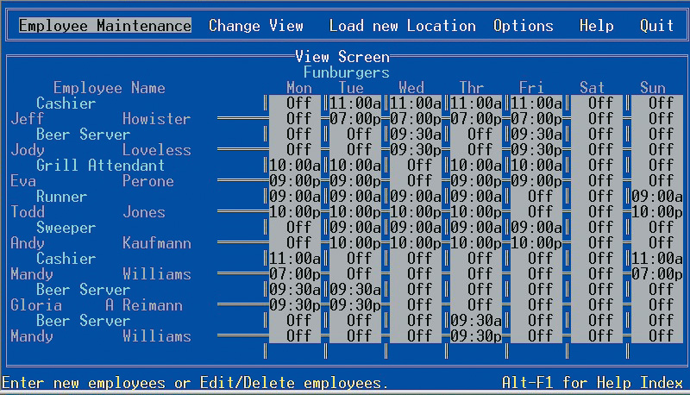
DOS Application

Slide 5
PC Operating Systems
Windows NT
Designed for a powerful system
32-bit OS
Very stable
Windows NT Workstation
Single user multi tasking OS
Windows NT Server
Multi user multi tasking OS
Network operating system

Slide 6
PC Operating Systems
Windows 9x
95, 98, and Millennium Edition (Me)
32-bit OS
Supported 16-bit programs well
Very pretty not stable OS
Still found in large corporations
95 introduced the Start button
98 introduced active desktop
Me improved multimedia software

Slide 7
PC Operating Systems
Windows 2000
Look of 9x with NT stability
Optimized for office and developers
Application software ran very well
Entertainment software ran very poorly
Notes:
Discussion point
There are many computer professionals that say that Windows 2000 was the first stable Microsoft product. Engage your class in a discussion regarding a software developer’s obligation to create stable products.

Slide 8
PC Operating Systems
Windows XP
Microsoft’s newest desktop product
Different look from 2000
Many different versions
Digital multimedia support was enhanced
Communications was enhanced
Mobile computing became a priority
Notes:
Teaching tip
At press time, the 64 bit version of XP was still in the late beta stage. More information can be found at www.microsoft.com/presspass/press/2003/sep03/09-23athlon64betapr.asp.

Slide 9
PC Operating Systems
UNIX
Runs on all computer types
32- or 64-bit
Very stable and fast
Command-line interface
Can cost thousands of dollars

Slide 10
PC Operating Systems
Linux
Free or inexpensive version of UNIX
32-bit OS
Very stable and fast
Most flavors are open source
X Windows GUI
Command line interface is available

Slide 11
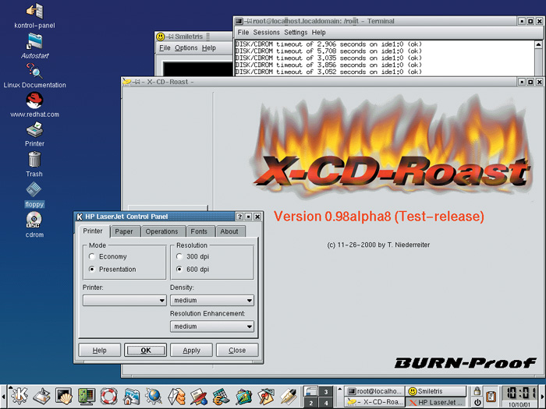
Linux Desktop

Slide 12
PC Operating Systems
Macintosh operating systems
OS X
Based on FreeBSD Linux
Very stable and easy to configure
Only runs on Mac hardware
Notes:
Teaching tip
OS X versions change often. Keep track of the most current and present this to the class. Visit www.apple.com/macosx/ to keep up to date. At press time the latest version was 10.4 Tiger.

Slide 13
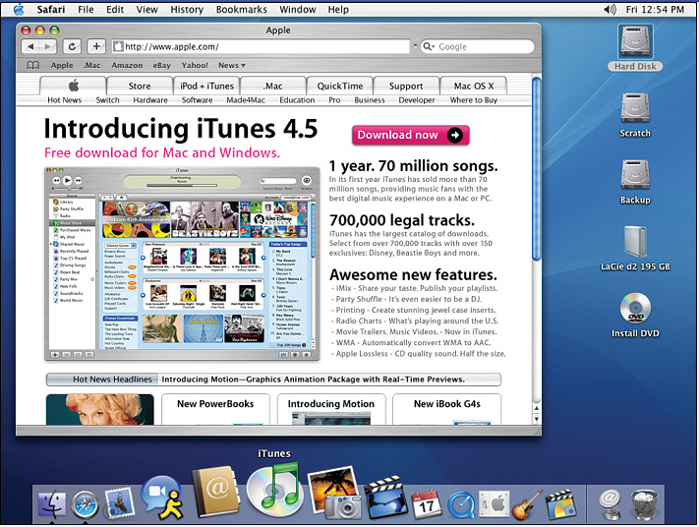
OS X Desktop

Slide 14
NOS Features
Network operating system
Fast and stable
Runs on servers
Multi-user and multitasking OS
32- or 64-bit

Slide 15
NOS Features
File and print sharing
Users access the same files
Hundreds of users use a printer
Different OS can interact

Slide 16
NOS Features
Data integrity
Backups copies data onto tape
RAID copies data onto other drives
Redundant Array of Inexpensive Disks
Relies on two or more hard drives
May speed access to data

Slide 17
NOS Features
Data security
Access to data can be restricted
Access to server resources is controlled
Audits can be kept
Notes:
Teaching tip
Tell your students what NOS your school uses.

